Slide 1
Title: To-Do List App
Subtitle: A Simple Task Management Web Application
Presented by: Siva Ratnam

Slide 2
Introduction
The To-Do List App is a simple and interactive web application.
It helps users manage tasks by adding, completing, and deleting them.
Built using HTML, CSS, and JavaScript.
Focused on user-friendly design and basic productivity features.

Slide 3
Working
Task Input: User enters a task in a text field.
Add Button: Adds the task to the task list.
Task List: Displays each task with a checkbox and delete button.
Checkbox: Marks the task as complete (often styled with a strikethrough).
Delete Button: Removes a task from the list.

Slide 4
Uses
Personal task tracking.
Daily activity planning.
Basic project to understand frontend development.
Can be extended to collaborative task management.

Slide 5
Advantages & Disadvantages
Advantages:
Simple and intuitive interface.
Easy to implement and customize.
Enhances productivity.
Disadvantages:
No backend/database (data lost on refresh).
Limited to individual use.
Not mobile-responsive by default (can be fixed with media queries).

Slide 6
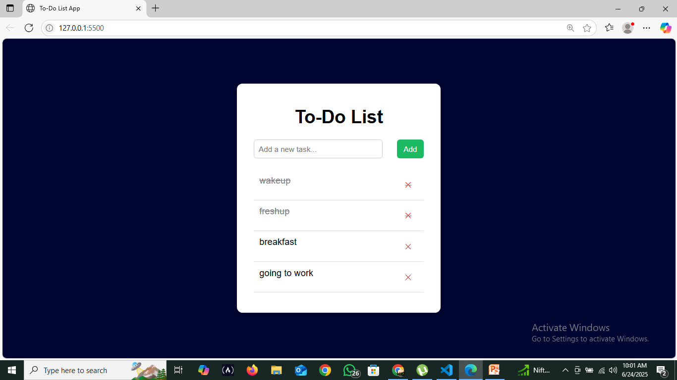
Screenshots

Slide 7
Future Scope
Add local storage or database support.
Implement user login and profile.
Enable drag-and-drop reordering of tasks.
Add notifications/reminders for deadlines.
Make it mobile-responsive.

